Slide 1
Take your education to the next level

Slide 2
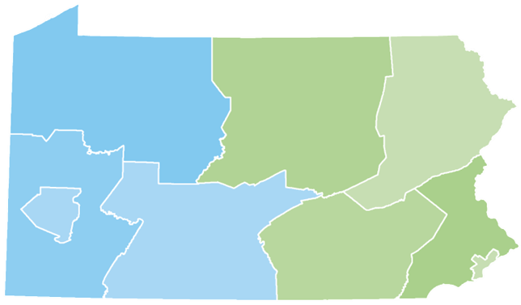
Your Presenter
Diona Brown
Higher Education Access Partner
PA Higher Education Assistance Agency (PHEAA)
Diona.brown@pheaa.org
Counties: Adams, Cumberland, Franklin, Fulton and York

Slide 3

Topics of Discussion
Financial Aid 101
  Financial Aid Basics
  Types & Sources of Aid
Federal & State Aid
Five Steps to Financial Aid
Applying for Aid
What Happens Next?
Final Thoughts
Questions

Slide 4

Financial Aid Basics
Financial Aid: financial assistance to help students pay the cost of an education at a post-secondary school.
Paying is the joint responsibility of the student and parent(s), to the extent possible
Eligibility criteria may apply in order to receive/maintain financial aid, such as:
  Students must maintain satisfactory academic progress
  Additional criteria may be required based on the type and source of aid
Students should play an active role in the process
  Talk with children about goals/plans (review educationplanner.org & mysmartborrowing.org)
  Take advantage of college fairs & school visits (ask about cost and available aid)
Some students may not qualify for all forms of aid
Must apply every year to be considered

Slide 5

Financial Aid Basics
Cost of Attendance(COA):
Costs that the student can expect to incur during the school year (direct + indirect costs)
Direct costs: billed by the school
Indirect costs: not included in bill but may be incurred
Expected Family Contribution (EFC)
A measure of how much the student & family are expected to contribute to the cost of the student’s education.
The EFC is calculated from a federal formula using info collected from the Free Application for Federal Student Aid (FAFSA)
School costs include:
  Tuition and fees
  Room and board
  Books and supplies
  Transportation
  Miscellaneous living expenses
Financial Need = COA - EFC
Schools will determine need after reviewing financial aid applications
Schools will create an award package based on need and available funding at their schools

Slide 6

Types of Financial Aid
Gift Aid (Free Money)
  Grants: aid, based on financial need and generally does not have to be repaid
    Student must complete financial aid paperwork to determine eligibility
    Looks at COA & EFC
  Scholarships: aid, usually based on merit, that generally does not have to be repaid. Most students must meet certain qualifications to receive and maintain scholarships.
    Academic & athletic
    Talent (music, art, etc.)
    Grades, religious, ethnic or cultural background
    Select criteria determined by scholarship organization(s)

Slide 7

Types of Financial Aid
Self-Help Aid
  Work Study: Student obtains job, often coordinated through the campus and/or State.
    Wages earned help cover the cost of attendance
    Not offered at all schools
  Student Loans: Borrowed money that must be repaid (with interest)
    Federal Direct Loans -Student’s Name
    Federal PLUS Loans -Parent’s Name
    Private/Alternative Student Loans – Varies amongst lender

Slide 8
Federal Programs
Pell Grant: 2022-23 max award $6,895*
  Max amount reviewed every year
Campus-based aid: amounts determined by Financial Aid Office (FAO)
  FSEOG………………up to $4,000
  Federal Work-Study…FAO determines
For most programs, student must be enrolled at least half-time.
  Must complete the FAFSA
* Goes to most financially needy students

Slide 9

Pennsylvania State Grant
PA State Grant: 2022-23 max award $5,750
Awarded to eligible PA residents who demonstrate financial need
Required: approved school/ approved program of study
Out of State schools in DE, MA, OH, WV, VT & DC: max $600
  Veterans: up to $800
Cost Tier | Minimum Award | Maximum Award
$0 - $12,000 | $500 | $3,059
$12,001 - $19,000 | $500 | $4,894
$19,001 - $29,000 | $500 | $5,261
$29,001 - $32,000 | $500 | $5,750

Slide 10
PA State Administered Programs
State Work-Study - job related to major
Blind or Deaf Beneficiary Grant
Educational Assistance Grant (EAP) – National Guard
PA Military Family Education Program (MFEP)
Chafee Education and Training Grant – co-administered with the PA Department of Human Services
Foster Ed Tuition Waiver
Postsecondary Educational Gratuity Program (PEGP)
Partnerships for Access to Higher Education (PATH)
Pennsylvania Targeted Industry Program (PA –TIP)
Ready to Succeed Scholarship (RTSS)
For details, visit PHEAA.org.

Slide 11
Financial Aid Made Simple
Look for FREE money first
Know your specific deadlines
Fill out the FAFSA
Compare schools financial aid offers carefully
Be sure you have the money you need
5 Steps to Financial Aid
a Step 1 Step 2 Step 3 Step 4 Step 5

Slide 12
Step 1: Look For Free Money First
National
  Most found on corporate websites, scholarship databases & HS guidance offices/webpages
  Lots of competition
Local & Regional
    Check with HS Guidance office/webpage
    Businesses, churches, local foundations, etc. (stay on the lookout)
    Less competition
Post-Secondary:
    Check the school’s financial aid & admissions pages on website
    Inquire with financial aid office about scholarships from alumni and endowment funds

Slide 13
Scholarship Search
Don’t miss out on FREE money!
Start Early and Search Often
Create an Academic Resume:
  Academic success
  Extra Curricular Activities
  Community Involvement/Volunteerism
Create an Essay(s)- Write an essay, free from errors, that can be tweaked based on individual scholarships (be creative)
Secure Letter of Recommendations early
Pay attention to deadlines and understand the terms
FastWeb.com
EducationPlanner.org
Chegg.com
FinAid.org
ScholarshipExperts.com
Scholarships.com
Scholarship-Page.com
DoSomething.org/Scholarships
Colleges.Niche.com
StudentScholarships.org
BigFuture.Collegeboard.org
CollegeAnswer.com
CollegeNet.com
MeritAid.com
MORE….

Slide 14


Step 2: Know Your Deadlines
Applications for Admission
Deadlines for Scholarships
  Institutions, Outside Sources
Free Application for Federal Student Aid (FAFSA)
  Available October 1 of Senior Year
  Schools have Priority Deadlines
    Don’t have to have applied or been accepted to list schools on FAFSA

Slide 15
PA State Grant Deadlines
May 1 – If you plan to enroll in a degree program or a college transferable program at a junior college or other college or university (excludes community colleges)
August 1 – If you plan to enroll in a community college; a business, trade, or technical school; a hospital school of nursing; or a 2-year program that is not transferable to another institution

Slide 16
Free Application for Federal Student Aid: FAFSA
All students who wish to be considered for financial aid must complete the form.
Complete the correct FAFSA (2023-2024 AY)
Can start FAFSA and save to complete at a later time
File as early as October 1 of student’s senior year in high school
Plan to Attend College From | Submit the FAFSA From | Using Tax Information From
Jul 1, 2022 - Jun 30, 2023 | Oct 1, 2021 - Jun 30, 2023 | 2020
Jul 1, 2023 - Jun 30, 2024 | Oct 1, 2022 - Jun 30, 2024 | 2021
Jul 1, 2024- Jun 30, 2025 | Oct 1, 2023 - Jun 30, 2025 | 2022

Slide 17
Create Your FSA Accounts
The student applying for aid and one parent providing information on the FAFSA need to create an FSA account at studentaid.gov.
Create prior to completing the FAFSA.
Legal signature for student and parent.
Provides access to FAFSA and Federal Student Aid online systems.
After verifying, the mobile phone number can be used as the username to login.
Username
Password
Email Address
Mobile Phone
Security Questions
Social Security Number

Slide 18
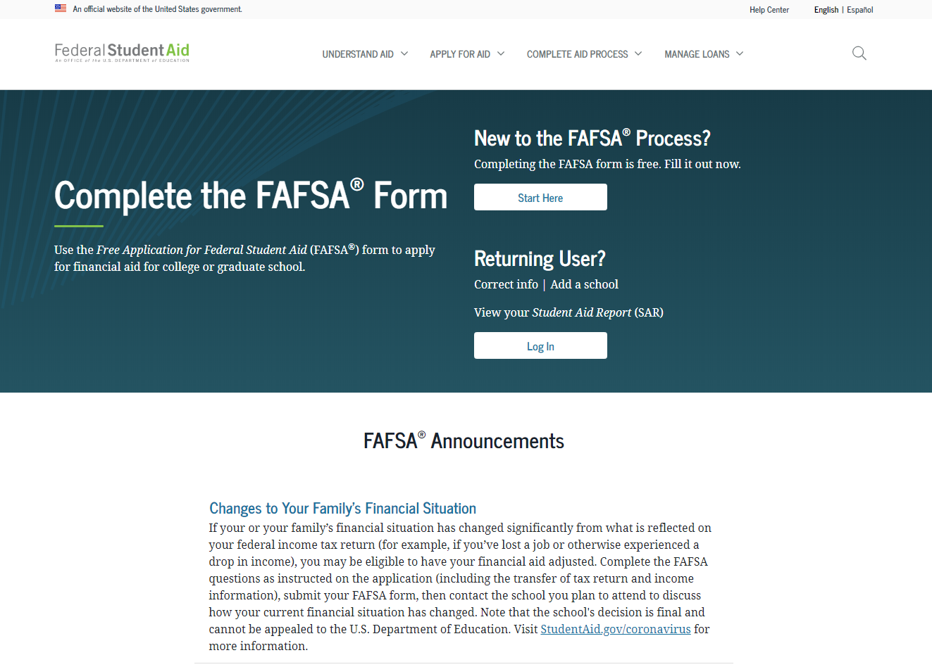

Free Application for Federal Student Aid (FAFSA)
PDF at studentaid.gov or
1-800-433-3243.
Studentaid.gov

Slide 19
2023-2024 FAFSA Prep
Information Needed for FAFSA
Social Security Numbers
Federal Tax Returns and
W-2’s (2021)
2021 Untaxed Income
Checking and Savings Account Statement Balances as of FAFSA Filing Date
Investment Records
Email Addresses
Student & Parent
Federal Student Aid
Account (FSA ID)

Slide 20
FAFSA Steps
Login – student or parent
Disclaimer – select accept
Application Year
Save Key
Introduction
Student Demo-graphics
School Selection
Dependency Status
Parent Demo-graphics
Financial Information
Sign and Submit
Confirmation

Slide 21
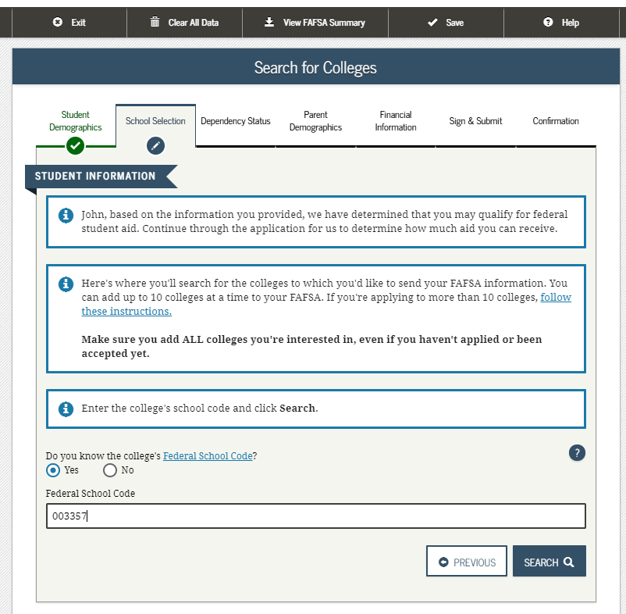
FAFSA - School Selection
School Selection:
  Must list at least 1 school
  Only schools listed will receive results of FAFSA
  Don’t have to have applied/been accepted to list school
  May go back and add schools at a later time
Can add up to 10 colleges at a time
NOTE: Once your Final Decision is made, Update your PA Grant Information with the school you WILL attend.

Slide 22
Whose information goes on the FAFSA?
YES
Student
Biological parents living in the same household
Adoptive parents
Divorced or separated parents:
  The parent the student lived with the most over the past 12 months
  If equal, then the parent who provided more than 50% of student’s support
Stepparent – If part of the student’s household
NO
Foster Parents
Legal Guardians
  By Court Order
Anyone else the student is living with

Slide 23


When Is A Student Considered an “Independent” student?
24 or older on Jan 1st of 2023
Married
Veteran (includes active-duty personnel)
Working on graduate level degree
Emancipated minor
Legal guardianship
Orphan, in foster care or ward of the court at
anytime when student was age 13 or older
Have legal dependents other than spouse
Student deemed homeless by proper authority
(PA State Grant status can be different)
Parent’s information is not required

Slide 24

Special Circumstances
If things change…
Recent death or disability
Reduced income/Unemployment
Unusual Circumstances
Financial hardship due to COVID-19
Contact schools listed on FAFSA: Only a school can change a FAFSA based on your circumstances
Contact PHEAA for the PA State grant

Slide 25
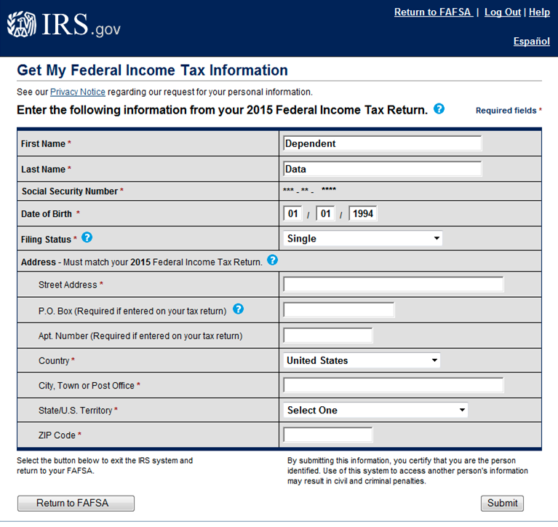
IRS Data Retrieval Tool (DRT)
The IRS DRT allows students and parents to transfer IRS tax return income into the FAFSA.
Unable to use DRT if :
  Married filing separate or Married filing Head of Household
  Filed a Puerto Rican or foreign return
  Marital status is different than status on tax return
  Identity Theft flag is on account
Enter the following information from your 2019 Federal Income Tax Return
All Info must match tax return!
All Information must match tax return!
P.O. Box addresses should use P.O. Box number only.

Slide 26

Financial Information:
Assets:
Some families qualify for a Simplified EFC Formula and do not need to report assets
If total asset amounts are higher than the Asset Protection Allowance, then the net value of the assets must be reported
  “As of today, does the total amount of your (parent’s) current assets exceed (a specific amount unique to the applicant)”
  Assets are reported as of the date the application is filed
  529 plans owned by the student or the custodial parent are reported as Parental Investments on the FAFSA
Do not report the value of:
  Qualified retirement funds
  Life insurance policies
  Primary home
  Family business, if it employs less than 100 full-time employees
  Family farm, if the family lives on the farm
Do not include: GI Bill, Dependents Education Assistance Program, VA Vocational Rehabilitation Program, VEAP Benefits, etc.

Slide 27
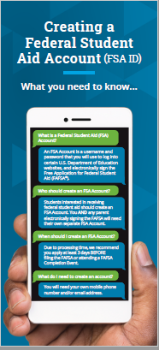
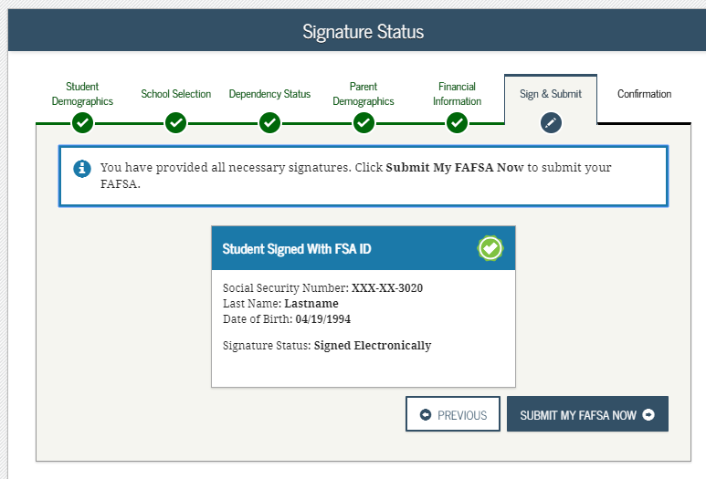
Federal Student Aid Account:
Don’t forget to sign!
Signature Options:
Federal Student Aid Account:
  allows the student and parent to electronically sign the FAFSA (student & 1 parent must sign)
  Signature is accepted for PA State Grant
Signature Page:
  Option if unable to sign electronically
  Follow instructions on FAFSA to print, sign and mail
  FAFSA is not considered received until the signature page has been received

Slide 28
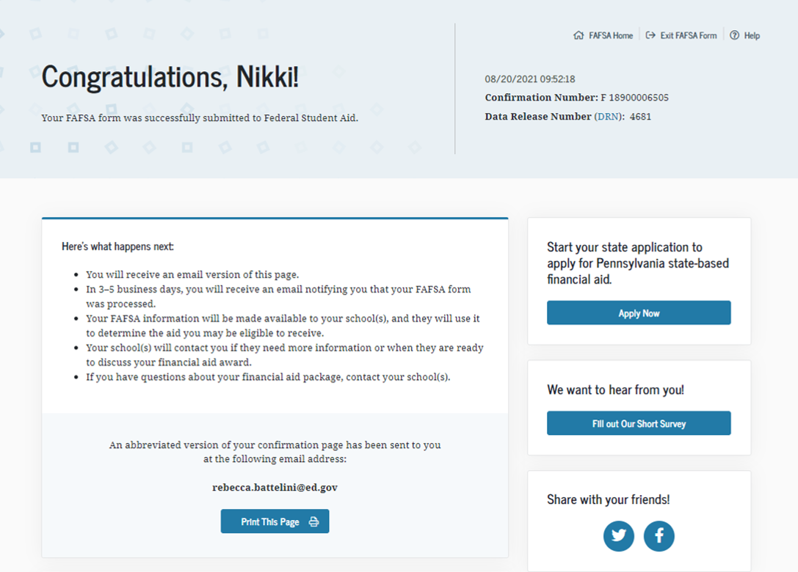
Confirmation Page & Link to the
PA State Grant Form

Slide 29

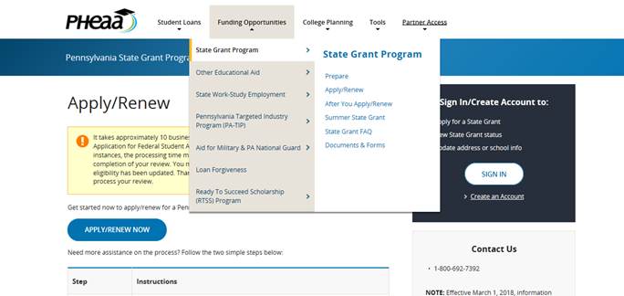
Online State Grant Application
Link off the FAFSA Application Confirmation Page
  Missed the link or it wasn’t
  available?
    Link in an email sent to
    student/parent from PHEAA,
    OR
    Go to PHEAA.org; State Grant
    Program; and complete the form.
Additional information needed to
determine PA State Grant eligibility:
  Enrollment status (full-time/part-time)
  Value of PA 529 College Savings
  Program
  Program of study for students in
  vocational programs
  Employment status
?
Help screens are available
for all questions

Slide 30
Financial Aid Forms
Additional form that may need to be completed:
State Grant Form (SGF) through PHEAA
    Required for first -year students (addl. information may be required in subsequent years)
    Can link to the State Grant application from FOTWs confirmation page or may access at www.pheaa.org
Some Schools Require:
CSS Profile (College Scholarship Service) required by some postsecondary schools and scholarship organizations
  https://student.collegeboard.org/css-financial-aid-profile
Institutional Financial Aid Forms
  Internal forms specific to each school
  Required by some schools

Slide 31
After Filing
In a few days an email will be sent to the student regarding the processing of their FAFSA and their Student Aid Report.
Students should monitor the email account provided on the FAFSA and respond to requests from Federal Student Aid, PHEAA and the colleges.
Information will be shared with PHEAA and all college choices.

Slide 32
Step 4: Compare Schools’ Financial Aid Notices Carefully
No standard format for Financial Aid Notices from schools.
Generally include type and amount of aid
Generally describes what needs to be done to accept the aid
Some notices include parent loans, some do not.
Scholarships:
  Are there conditions for maintaining it?
  Is the scholarship for the first year only or renewable?
Bottom Line: What are your out-of-pocket costs?

Slide 33
Comparing Packages
Cost | $20,000 | $30,000 | $50,000
EFC | $ 3,000 | $ 3,000 | $ 3,000
Need | $17,000 | $27,000 | $47,000
Free Money | $ 6,000 | $ 8,000 | $18,000
Loans | $ 5,500 | $ 7,000 | $ 8,000
Work-Study | $ 0 | $ 2,000 | $ 3,000
TOTAL AID | $11,500 | $17,000 | $29,000
Gap = (Cost – Aid) | $ 8,500 | $13,000 | $21,000
Actual Cont. = (Cost – Free $) | $14,000 | $22,000 | $32,000
  What happens if there is a gap and all costs are not covered?

Slide 34

Be a Smart Borrower
Exhaust all free financial aid options before borrowing student loans
Seek federal student loans before private student loans
Only borrower the amount needed (loans must be repaid)
Do your research!
MySmartBorrowing.org: An interactive, online tool created by PHEAA that helps students and families:
  Estimate career, salaries & college tuition
  View the impact of savings on overall cost
  Calculate loan repayment
  Avoid borrowing too much money
Select a
Career
Factor in Savings
Select a School
Get Results

Slide 35
Types of Federal Student Loans
Undergraduate Students
  Subsidized
  Unsubsidized
Graduate Students
  Unsubsidized
  Grad PLUS Loan
Parents
  PLUS Loan

Slide 36
Federal Direct Stafford Loan Borrowing Limits
Undergraduate Students |  |  | Graduate Students
Annual Limits | Dependent Students | Independent or dependent students whose parents are unable to borrow a PLUS Loan | Graduate or Professional Studies
1st Year | $5,500 Total No more than $3,500 may be subsidized | $9,500 Total No more than $3,500 may be subsidized | $20,500 each academic year Graduate / Professional students are no longer eligible for subsidized loans
2nd Year | $6,500 Total No more than $4,500 may be subsidized | $10,500 Total No more than $4,500 may be subsidized
3rd Year and beyond | $7,500 Total No more than $5,500 may be subsidized | $12,500 Total No more than $5,500 may be subsidized
Aggregate Limits | $31,000 Total No more than $23,000 may be subsidized | $57,500 Total No more than $23,000 may be subsidized | $138,500 Total No more than $65,000 may be subsidized

Slide 37

Student Loans
Federal Direct Loans
Federal PLUS Loans
Private Loans
Loan is in the student’s name
Max. borrowing limits
May receive a Direct Subsidized and/or Direct Unsubsidized loan
Fixed rate: 4.99%
Origination fee of 1.057% of the amount requested
Deferred payments
Must complete the FAFSA
Must complete entrance exam & MPN
Loan is in the parent’s name
Must meet credit requirements
  May apply with a credit worthy cosigner
  If denied, student may borrow additional unsubsidized amount
May borrower up to the COA minus any other aid
Fixed interest rate: 7.54%
Origination fee of 4.228%
Payments may be deferred
Student must complete the FAFSA
Loan is in the student’s name (cosigner is generally required)
Student or Cosigner must meet income & credit requirements
May borrower up to the COA minus any other aid
Variable or fixed interest rate
May have cosigner release clauses
Terms vary by lender
  Do your research
  Read the fine print

Slide 38

PA’s Low-Cost Way
to Pay for College!
Low, Fixed Rates
3.73 - 6.69%
1,2
^{APR}
Effective as of 5/12/21
Learn more at PHEAA.org/PAForward
1) Annual Percentage Rate (APR) Calculations – The lowest APR is based on the following assumptions: a loan of $10,000 made in a single disbursement, a student borrower who selected an Immediate Repayment Plan and a repayment term of 120 months, monthly payments of $100.87 and a final payment $78.29, a fixed periodic interest rate of 4.17%, and a total amount financed of $11,980.40. The student borrower in this sample qualified for a 0.25% Direct Debit benefit for the entirety of the repayment period and a 0.50% graduation benefit was applied 47 months into repayment. The highest APR is based on the following assumptions: a loan of $10,000 made in a single disbursement, a student borrower who selected a Fully Deferred Repayment Plan and a repayment term of 180 months, monthly payments of $117.93, a fixed periodic interest rate of 7.07%, and a total amount financed of $21,227.72. The student borrower received an in-school deferment of 46 months and a grace period of 6 months. The student borrower in this sample did not qualify for any interest rate discounts. These APRs are estimates and may differ from the actual rates received.
2) The provided rate range includes Undergraduate, Graduate, and Parent loans and may change based on loan type, loan term, repayment plan, and applicable discounts (not all discounts apply to all loan products). See individual loan programs for more specific information. PHEAA uses applicant credit scores to determine eligibility and interest rates. Higher credit scores may mean an applicant is offered a lower interest rate.
Applicants, including co-signers, are subject to credit qualifications, completion of an application and credit agreement, and verification of application information. PHEAA uses applicant(s) FICO score(s) to determine eligibility and interest rates. Higher credit scores may mean an applicant is offered a lower interest rate.
PHEAA reserves the right to discontinue all programs or benefits without prior notice.

Slide 39
What Can You Do Now?
Apply for FSA ID Account
Visit College Websites
Talk about what is affordable
Use Net Price Calculators
Explore Scholarships

Slide 40

Resources –
College & Career Planning Websites
PHEAA.org
EducationPlanner.org
MySmartBorrowing.org
YouCanDealWithIt.com
PHEAA toll free: 800-692-7392
Federal Student Aid Info Center: 800-433-3243
StudentAid.gov – general financial aid info

Slide 41
Your Presenter
Diona Brown
Higher Education Access Partner
PA Higher Education Assistance Agency (PHEAA)
Diona.brown@pheaa.org
Counties: Adams, Cumberland, Franklin, Fulton, and York
Notes:
To be revised by each Access Partner

